Slide 1
Floating Point

Slide 2
Topics
Fractional Binary Numbers
IEEE 754 Standard
Suggested Reading: 2.4

Slide 3


Encoding Rational Numbers
Form V =
Very useful when >> 0 or <<1
An Approximation to real arithmetic
From programmer’s perspective
  Uninteresting
  Arcane and incomprehensive

Slide 4
Fractional Binary Numbers
2^{m}
2^{m–1}
4
• • •
2
1
b_{m}
b_{m–1}
• • •
b₂
b₁
b₀
.
b_{–1}
b_{–2}
b_{–3}
• • •
b_{–n}
1/2
1/4
• • •
1/8
2^{–n}

Slide 5
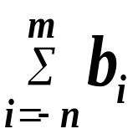
Fractional Binary Numbers
Bits to right of “binary point” represent fractional powers of 2
Represents rational number: 2^{i}

Slide 6
Fractional Numbers to Binary Bits
unsigned result_bits=0, current_bit=0x80000000
for (i=0;i<32;i++) {
x *= 2
if ( x>= 1 ) {
result_bits |= current_bit ;
if ( x == 1)
break ;
x -= 1 ;
}
current_bit >> 1 ;
}

Slide 7
Fraction Binary Number Examples
Value Binary Fraction
0.2 0.00110011[0011]
Observations:
  The form 0.11111…11 represent numbers just below 1.0 which is noted as 1.0-ε
  Binary Fractions can only exactly represent x/2^{k}
  Others have repeated bit patterns

Slide 8
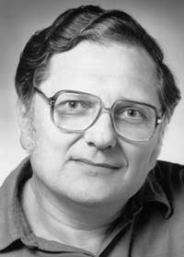
Encoding Rational Numbers
Until 1980s
  Many idiosyncratic formats, fast speed, easy implementation, less accuracy
IEEE 754
  Designed by W. Kahan for Intel processors (Turing Award 1989)
  Based on a small and consistent set of principles, elegant, understandable, hard to make go fast

Slide 9
IEEE Floating-Point Representation
Numeric form
  V=(-1)^{s}×M × 2E
    Sign bit s determines whether number is negative or positive
    Significand M normally a fractional value in range [1.0,2.0).
    Exponent E weights value by power of two

Slide 10
IEEE Floating-Point Representation
Encoding
  s is sign bit
  exp field encodes E
  frac field encodes M
Sizes
  Single precision (32 bits): 8 exp bits, 23 frac bits
  Double precision (64 bits): 11 exp bits, 52 frac bits
s
exp
frac

Slide 11
Normalize Values
Condition
  exp ≠ 000…0 and exp ≠ 111…1
Exponent coded as biased value
  E = Exp – Bias
    Exp : unsigned value denoted by exp
    Bias : Bias value
      Single precision: 127 (Exp: 1…254, E : -126…127)
      Double precision: 1023 (Exp: 1…2046, E : -1022 …1023)
      In general: Bias = 2^{m-1} - 1, where m is the number of exponent bits

Slide 12
Normalize Values
Significand coded with implied leading 1
  m = 1.xxx…x₂
    xxx…x: bits of frac
    Minimum when 000…0 (M = 1.0)
    Maximum when 111…1 (M = 2.0 – ε)
    Get extra leading bit for “free”

Slide 13
Normalized Encoding Examples
Value: 12345 (Hex: 0x3039)
Binary bits: 11000000111001
Fraction representation: 1.1000000111001*2¹³
M: 10000001110010000000000
E: 10001100 (140)
Binary Encoding
  0100 0110 0100 0000 1110 0100 0000 0000
  4640E400

Slide 14
Denormalized Values
Condition
  exp = 000…0
Values
  Exponent Value: E = 1 – Bias
  Significant Value m = 0.xxx…x₂
    xxx…x: bits of frac

Slide 15
Denormalized Values
Cases
  exp = 000…0, frac = 000…0
    Represents value 0
    Note that have distinct values +0 and –0
  exp = 000…0, frac ≠ 000…0
    Numbers very close to 0.0
    Lose precision as get smaller
    “Gradual underflow”

Slide 16
Special Values
Condition
  exp = 111…1

Slide 17
Special Values
exp = 111…1, frac = 000…0
  Represents value ∞ (infinity)
  Operation that overflows
  Both positive and negative
  E.g., 1.0/0.0 = −1.0/−0.0 = +∞, 1.0/−0.0 = −∞

Slide 18
Special Values
exp = 111…1, frac ≠ 000…0
  Not-a-Number (NaN)
  Represents case when no numeric value can be determined
  E.g., sqrt(–1), ∞ − ∞

Slide 19
Summary of Real Number Encodings
−∞
+∞
-Normalized
-Denorm
+Denorm
+Normalized
NaN
−0
+0
NaN

Slide 20
8-bit Floating-Point Representations
7
6
3
2
0
s
exp
frac

Slide 21
8-bit Floating-Point Representations
Exp exp E 2E
0 0000 -6 1/64 (denorms)
1 0001 -6 1/64
2 0010 -5 1/32
3 0011 -4 1/16
4 0100 -3 1/8
5 0101 -2 1/4
6 0110 -1 1/2
7 0111 0 1
8 1000 +1 2
9 1001 +2 4
10 1010 +3 8
11 1011 +4 16
12 1100 +5 32
13 1101 +6 64
14 1110 +7 128
15 1111 n/a (inf, NaN)

Slide 22
Dynamic Range (Denormalized numbers)
s exp frac E Value
0 0000 000 -6 0
0 0000 001 -6 1/8*1/64 = 1/512
0 0000 010 -6 2/8*1/64 = 2/512
…
0 0000 110 -6 6/8*1/64 = 6/512
0 0000 111 -6 7/8*1/64 = 7/512

Slide 23
Dynamic Range
s exp frac E Value
0 0001 000 -6 8/8*1/64 = 8/512
0 0001 001 -6 9/8*1/64 = 9/512
…
0 0110 110 -1 14/8*1/2 = 14/16
0 0110 111 -1 15/8*1/2 = 15/16
0 0111 000 0 8/8*1 = 1
0 0111 001 0 9/8*1 = 9/8

Slide 24
Dynamic Range (Denormalized numbers)
s exp frac E Value
0 0111 010 0 10/8*1 = 10/8
…
0 1110 110 7 14/8*128 = 224
0 1110 111 7 15/8*128 = 240
0 1111 000 n/a inf

Slide 25
Distribution of Representable Values
6-bit IEEE-like format
  K = 3 exponent bits
  n = 2 significand bits
  Bias is 3
Notice how the distribution gets denser toward zero.

Slide 26
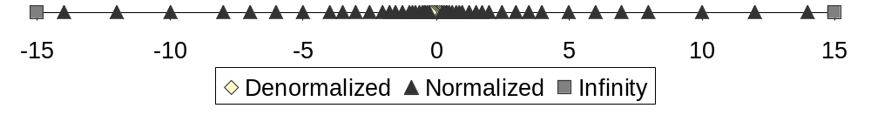
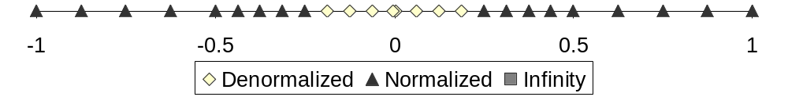
Distribution of Representable Values

Slide 27
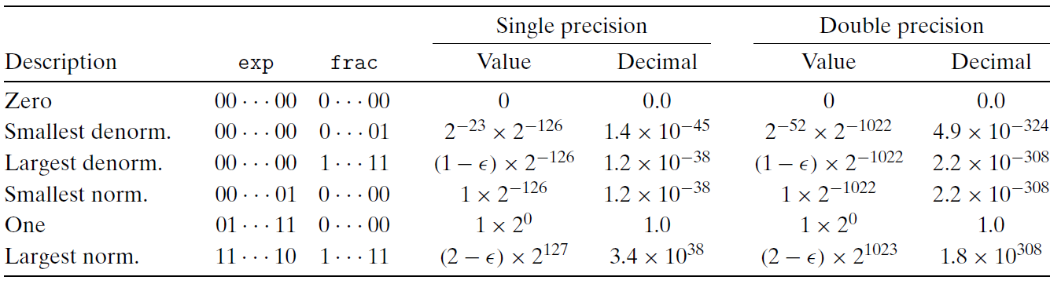
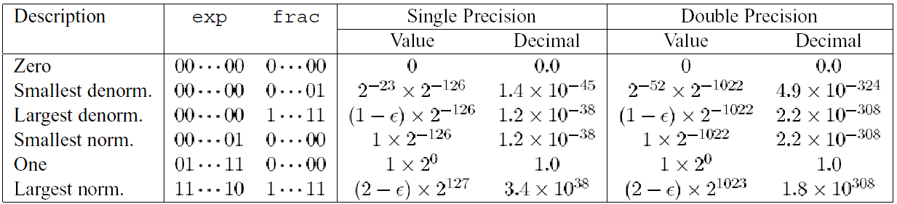
Interesting Numbers

